Slide 1

Differential Privacy
REU Project Mentors:
Darakhshan Mir
James Abello
Marco A. Perez

Slide 2
What is Differential Privacy?
One’s participation in a statistical database should not disclose more information that is otherwise public.

Slide 3
What is differential privacy?
Neighboring databases can only differ by, at most, one entry.
x
x'
ID | Age
Martin | 24
Neel | 29
Marco | 21
Ming | 23
ID | Age
Martin | 24
Neel | 29
Marco | 21

Slide 4
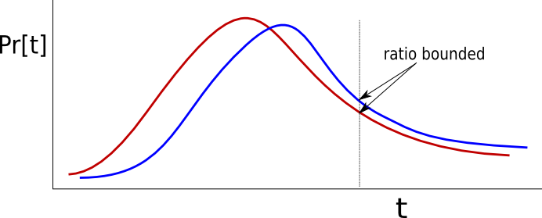
Definitions
ε-Differential Privacy

Slide 5
Definitions
Global Sensitivity
Global sensitivity, GS_{f,} of f, is the maximum change in f over all neighboring instances
    GS_{f} ≤ |f(x)-f(x')|
Add noise to “mask” this change.

Slide 6
Why is it important?
Enables the sharing of information to be analyzed by experts without sacrificing the privacy of the participants.
It reduces the amount of noise needed to preserve privacy, while maintaining the utility of the data.

Slide 7
Differential Graph Privacy
The same notion of privacy can be extended from databases to graphs.
Private transformations seek to alter graphs so that the main features of the original graph are reasonably preserved (degree distribution, clustering coefficient, etc.)

Slide 8
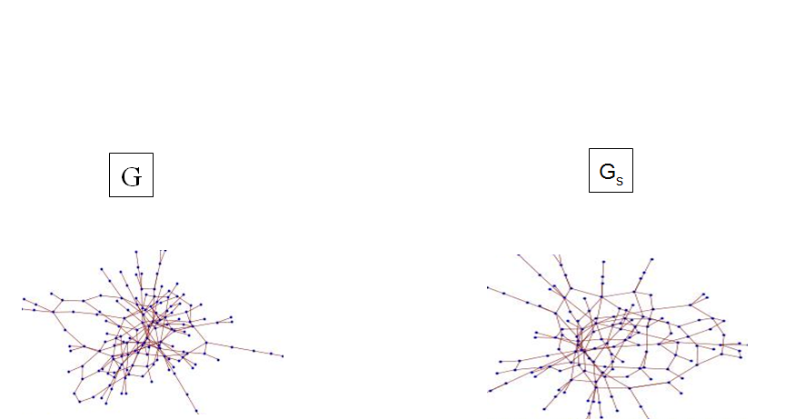
Graph transformation
TRANSFORMATION

Slide 9
Types of Differential Graph Privacy
Node-differential Privacy
two graphs are neighbors if they differ by at most one node and all of its incident edges.
Edge-differential Privacy
Two graphs are neighbors if they differ by at most one edge

Slide 10
Focus of Research
Triangle
The number of triangles within a graph help us calibrate the noise adequately, taking into account the fact that the existence of triangles in a graph have an overbearing impact on global sensitivity.

Slide 11
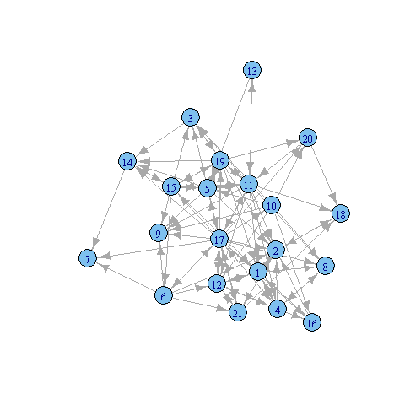
Conclusion
I will focus on the study various notions of sensitivity of the number of triangles of a graph in different kinds of graphs.

Slide 12
Thank you!
Any Questions?

